Slide 1
Minor Labor Laws
Sean Seibert
Investigator Supervisor
Bureau of Wage and Hour Administration

Slide 2
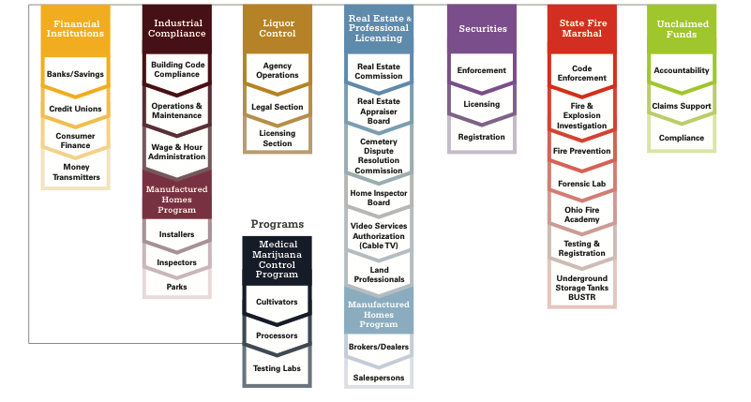
2
Overview of your division, how it plays a role in Commerce as a whole, etc.
The Ohio Department of Commerce is focused on equipping businesses and protecting consumers.
Commerce has seven divisions, including the Division of Real Estate & Professional Licensing.
Our goal is to keep Ohioan’s safe, sound and secure.

Slide 3
Employing Minors
Records Keeping Requirements
Exempted Minors
Hour Restrictions
Prohibited Occupations

Slide 4
Employer Minor Record Keeping Requirements
In Addition to Records for All Employees an Employer Must keep the following records pertaining to Minors:
  Work Permit
    Obtained through the Local School District
  Wage Agreement
    Listing the Wages to be Paid to the Minor

Slide 5
Employer Minor Record Keeping Requirements (cont.)
  Record of Breaks
    Showing the Starting and Stopping Time
  List of Minor Employed in a conspicuous place
  Minor Labor Law Poster

Slide 6
Minors Exempt from Minor Labor Law
Students participating in a vocational program approved by ODE
Students working in training department of any school
Minors participating in a play, pageant, or concert

Slide 7
Minors Exempt from Minor Labor Law (cont.)
Participation without remuneration of a minor and with the consent of the parent or guardian in a performance given by a church, school or academy
Minors employed by their parents in occupations other than those prohibited

Slide 8
Minors Exempt from Minor Labor Law (cont.)
Minors engaged in the delivery of newspapers to consumers
Minors who have received a high school diploma
Minors who are currently heads of households or parents contributing to the support of their children

Slide 9
Minors Exempt from Minor Labor Law (cont.)
Minor engaged in lawn mowing and snow shoveling
Minors in agriculture employment in connection with family farms
Students participating in a program to serve as precinct officers

Slide 10
Hour Restrictions
16 & 17 yr. old: May not work past 11:00 p.m. on any night followed by a school day
14 & 15 yr. old: May not work past 7:00 p.m. when school is in session and 9:00 p.m. when school is not in session
14 & 15 yr. old: May not work more than 3 hours per day and 18 hours/week when school is in session
14 & 15 yr. old: May not work more than 8 hours per day and 40 hours/week when school is not in session

Slide 11
Prohibited Occupation for ALL Minors
Driving a Motor Vehicle (some exceptions may apply)
Meat Slicers
Power-driven bakery machines
Roofing
Excavation
Work in connection with Chemicals
Power paper machines

Slide 12
Prohibited Occupation for 14 & 15 Year Old Minors
Power-driven machines
Construction
Cooking and Baking (except for lunch counters, snack bars, cafeteria serving counters)
Gasoline Service in connection with pits, rack or lifting apparatus

Slide 13
Prohibited Occupation for 14 & 15 Year Old Minors (cont.)
Warehouse work
Work in freezers and meat coolers
Any manufacturing occupation

Slide 14
4109.22 Manufacturing Mentorship Program
Passed by the Ohio State Legislature in 2019 to expose minors who are sixteen or seventeen years of age to manufacturing occupations in this state through temporary employment with an employer.

Slide 15
Requirements by the manufacturer for employing minors under the manufacturing mentorship program
(1) Determine the duration of the minor's employment;
(2) Assign the minor a mentor to provide direct and close supervision while the minor is engaged in any workplace activity;
(3) Provide the minor with the training described in division (C) of this section;
(4) Encourage the minor to participate in a career-technical education program approved by the department of education if the minor is not participating in a career-technical education program when the minor begins employment;
(5) Comply with all applicable state and federal laws and regulations relating to the employment of minors (work permits, wage agreements, hour restrictions and the payment of the required minimum wage).

Slide 16
Additional requirements pertaining to the Manufacturing Mentorship Program
(E) A minor who is sixteen or seventeen years of age who is employed by an employer under the mentorship program may work in any manufacturing occupation not denied by law to minors of that age under section 4109.05 of the Revised Code or rules adopted under that section.
(F) No employer shall do either of the following:
(1) Permit a minor who is sixteen or seventeen years of age to operate a tool minors of that age are permitted to operate pursuant to the rules adopted under division (D) of this section unless the minor is employed by the employer under the mentorship program;
(2) Permit a minor who is sixteen or seventeen years of age who is employed by the employer under the mentorship program to operate a tool prohibited for use by minors of that age pursuant to the "Fair Labor Standards Act of 1938," 29 U.S.C. 201, et seq., and section 4109.05 of the Revised Code or rules adopted under that section.

Slide 17
Required training under Division (C)
(1) An employer employing a minor who is sixteen or seventeen years of age in a manufacturing occupation under the mentorship program shall provide the minor with training that includes all of the following:
(a) A ten-hour course in general industry safety and health hazard recognition and prevention approved by the occupational safety and health administration of the United States department of labor;
(b) Instructions on how to operate the specific tools the minor will use during the minor's employment;
(c) The general safety and health hazards to which the minor may be exposed at the minor's workplace;
(d) The value of safety and management commitment;
(e) Information on the employer's drug testing policy.

Slide 18
Legislative Rules for allowable tools/equipment to be used under the Manufacture Mentorship Program and Wage & Hour Enforcement Rules on the program
Since they have not been formally adopted yet, we ask that you contact our Chief, Steve Clegg, at 614-728-8686 to determine whether or not the tools/equipment that you are wishing to train the sixteen or seventeen year old to operate is permissible.

Slide 19
Thank You
  Contact Information
  Sean Seibert
  Investigator Supervisor, Bureau of Wage & Hour Administration
  Ohio Department of Commerce
  Bureau of Wage and Hour
  P.O. Box 4009
  6606 Tussing Road
  Reynoldsburg, Ohio 43068-9009
  614-557-8662
  Sean.seibert@com.ohio.gov

